Slide 1

Blind Vision
Team: Helldiver
Aditya Sajeev Celio F. Kelly
Ismael Retana Joshua Brown
Rishi Meka Tommy Wright

Slide 2
Project Phase 1
System Requirements Specification
Professor/Instructor: Dr. Lawrence Chung
Teaching Assistant: Vlad Birsan

Slide 3
Summary
AS-IS and TO-BE
Requirement Engineering Process
Preliminary Definition Issues
Prototype/Prototype Mockup

Slide 4
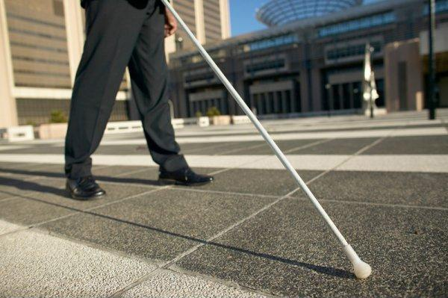
AS-IS (Problem)
Partial, Complete, Congenital, Legal, and Nutritional are some of the example that a person might have vision lost.
Blind people current don’t have a way to navigate safely at UTD (ex. not able to avoiding obstacle and not able to read sign of the room)
People with vision disability will have a difficult time contacting emergency services (ex. UTD and UTD Police).

Slide 5

TO-BE (Solutions)
Help blind people to travel safely indoor at UTD from one destination to another while avoiding obstacle.
For it to work we would need an assistant AI that will do the work for us.
Providing assistant services for emergency

Slide 6
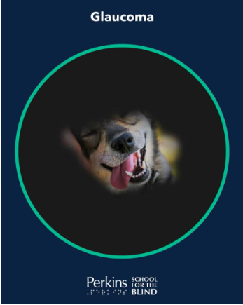
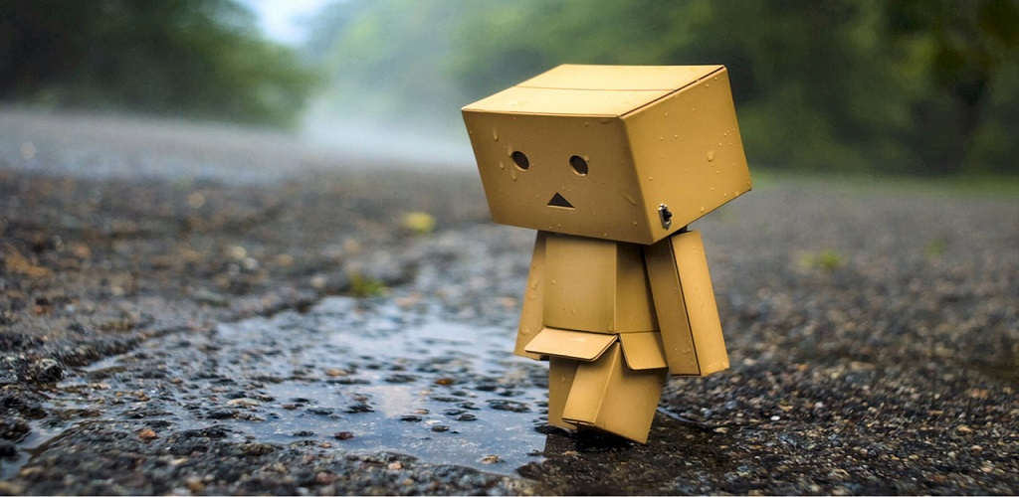
AS-IS Scenario 1
Timmy has glaucoma, a type of blindness where it limit of what Timmy can see around the surrounding area.
Timmy is at UTD and his next class is in ECSW 1.365. While he’s walking there, Timmy bumps into multiple wall, glass door, wet sign, and chairs.
Timmy become very sad and frustrated.

Slide 7

TO-BE Scenario 1
To solve the problem, our application will escort Timmy from one destination to another while safely avoiding obstacles that are in his way.
That way Timmy can stay focus on getting his Software Engineering degree and be happy once again.

Slide 8
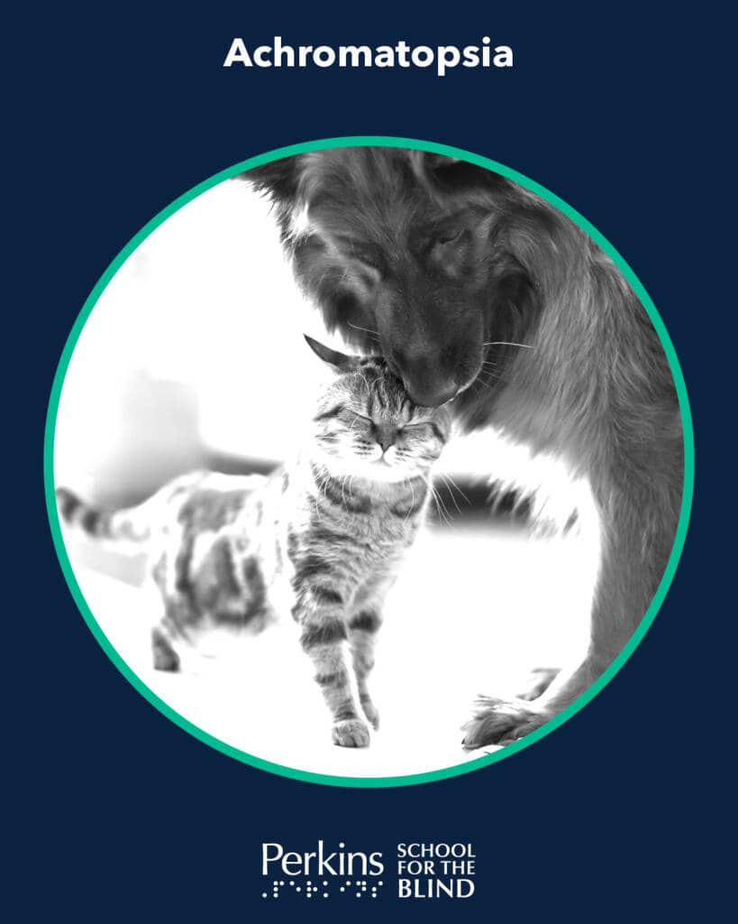

AS-IS Scenario 2
Tammy, a visitor at UTD, she has Achromatopsia. A blindness where she can not see colors, but only black and white.
Tammy was looking for ECSW 1.365, but she can not find it due to the overpowering of the contrast on her eyes.
Tammy become sad and angry.

Slide 9
TO-BE Scenario 2
Our application will guide Tammy safely from her current location to the room that she was looking for, while avoiding obstacles.
That way Tammy would likely to choose UTD for her school

Slide 10
Requirement Engineering Process

Slide 11
Process-Model
The spiral process was chosen since the project is small and only will go over two phases.
Blind Vision
Phase 1
Agreed Req.
Req. Elicitation
Req. Analysis/ Negotiation
Req. Document and Validation Report
Start
Agreed Req.
Req. Validation
Req. Documentation
Draft Req. Document

Slide 12
Stakeholders
Of: Lawrence Chung, Accessibility Office, and UTD Police.
By: Team 1 (Helldiver)
For: Blind people, Accessibility Office, UTD Police, and user that assist blind.
WRS Document reference: Content: -Page

Slide 13
Preliminary Definition Issue

Slide 14
WRSPM Model
Environment
System
D1:The accelerometer can detect if the user falls.
C1: Accelerometer detects the rapid changes in the user’s position.
S1: GPS identifies the user’s location.
D2: Blind users can use an app to navigate inside UTD buildings.
C2: The exact location can be sent to emergency contact.
S2: System uses the camera to identify text on signs and doors, then reads it.
S1:
S2:
D3: The camera, LiDAR, and GPS work to scan the area for obstacles.
C3: Can make call by voice command in an emergency situation.
S3: System can ask if the user needs assistance.
S4: System can warn the user if camera or sensors are blocked.
C4: Read and vocalize the screen content to the user.
R1: Use should be able to create an account and enter data.
R2: User should be able to clearly hear the sounds made by the app.
C5: Mic can detect the user’s voice for entering inputs and commands.

Slide 15
Domain | Domain Issue
D 1: The accelerometer can detect if the user falls. | DI 1: Accurate indoor navigation is challenging without the aid of GPS signals.
D 2: Blind users can use an app to navigate inside UTD buildings. | DI 2: It must address the complexity of obstacles within the building.
D 3: The camera, LiDAR, and GPS work to scan the area for obstacles. | DI 3: User privacy and data security are paramount, given the application's access to sensitive information.

Slide 16
Functional Requirements
FR 1: The app shall allow users to enter data to create an account.
FR 2: The app shall access and use microphone, camera, lidar, accelerometer, and GPS.
FR 3: The app shall guide users to navigate indoors at UTD buildings safely.
FR 4: The app shall detect if the user falls and needs assistance and send a message and location to his/her emergency contact.
FR 5: The app shall detect if the smartphone camera and other sensors are covered and ask the user to stop.
FR 6: The app shall be able to read signs “text” to the user.

Slide 17
Non-Functional Requirements
NFR 1: The app shall be available and running 24/7.
NFR 2: The app shall be feasible to maintain.
NFR 3: The app shall navigate the users safely indoors.
NFR 4: The app shall be scalable to be implemented in other OS or new features.

Slide 18
Functional Requirements Issue | Non-Functional Requirements Issue
FRI 1: Determined how the user can input values to create account. | NFRI 1: Using iPhone hardware and UTD map API bring the cost down significantly.
FRI 2: Ensure that the app can access the hardware and sensors. | NFRI 2: To guarantee indoors navigation the app is dependable of UTD map API.
FRI 3: Use UTD map API to guarantee the user can navigate independently of internet connection. | NFRI 3: Design the app for future scalability.

Slide 19
Req. Specification
Problems
How can a blind person avoid obstacles through an environment using this app?
How can a blind person identify objects around them using the app?
How can a blind person stay safe in an emergency using this app?
Goals
Improve obstacle safety
Increase surroundings awareness
Enhance emergency help
WRS Document reference: Content: -Page

Slide 20
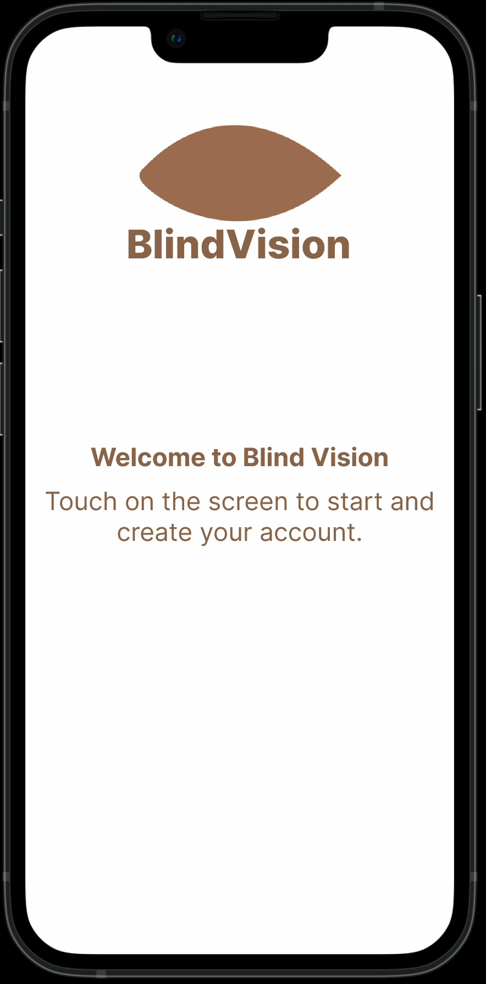
Prototype
Blind Vision app demonstration

Slide 21
Blind Vision
Why should you choose us?

Slide 22
Creeping Rate
We expect to see about 15-30% of requirements change through the course of the project as we get more customer feedback, but we hope to limit the increase in scope. This is due to an increase in scope resulting in less streamlined efficiency and focus.
Phase 1 |  |  |  | Phase 2
Functional Req. |  | Non-Functional Req. |  | Functional Req. |  | Non-Functional Req.
Total | Coverage % | Total | Coverage % | Total | Coverage % | Total | Coverage %
6 | 50% | 4 | 50% | N/A | N/A | N/A | N/A
*% show how much of the defined FR & NFR the team will be able to delivery

Slide 23
Questionnaire Targets
User Satisfaction Insight
Areas for Improvement
Feature Validation
Product Development Roadmap
Competitive Analysis

Slide 24
Questions?

Slide 25
References
Blind Vision WRS
Prototype:
https://www.figma.com. Accessed March 27th, 2024
Pictures:
https://www.yourdentistryguide.com/smile-anatomy/. Accessed March 26th, 2024
https://www.euractiv.com/section/health-consumers/news/workplace-prejudice-keeps-blind-people-out-of-employment/. Accessed March 26th, 2024
https://www.perkins.org/what-blindness-really-looks-like/. Accessed March 27th, 2024
https://www.amazon.com/HD-Wallpaper-Creators-Sad-Wallpapers/dp/B0768BZ71P. Accessed March 27th, 2024
https://rachelziv.com.au/word-happy/. Accessed March 27th, 2024
https://willingway.com/what-is-anger/. Accessed March 27th, 2024
WRS Document reference: Content: -Page

